Slide 1



Call Center Trends
View in Power BI
Last data refresh:
4/5/2022 9:01:01 PM UTC
Downloaded at:
4/6/2022 3:04:11 AM UTC

Slide 2
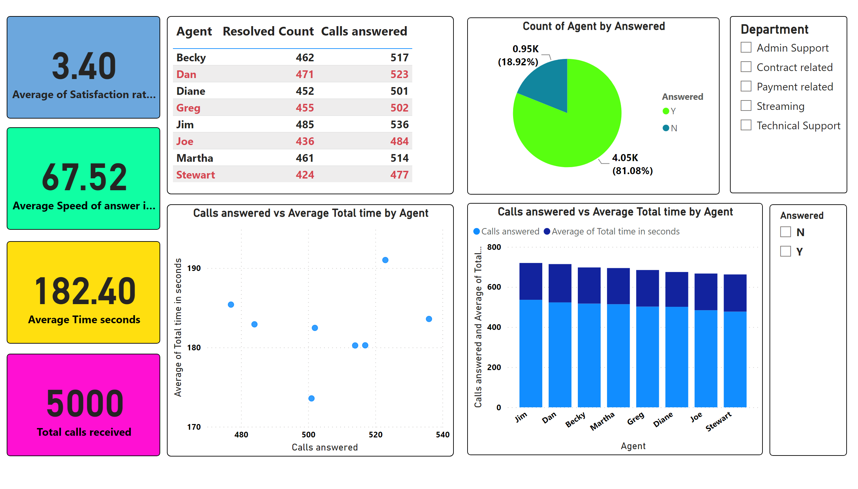
Page 1
Notes:
card
No alt text provided
card
No alt text provided
card
No alt text provided
card
No alt text provided
tableEx
No alt text provided
slicer
No alt text provided
pieChart
No alt text provided
Calls answered vs Average Total time by Agent
No alt text provided
Calls answered vs Average Total time by Agent
No alt text provided
slicer
No alt text provided
slicer
No alt text provided

